Slide 1
Structural Gaps in Cascade Framework
Hitarth Girishkumar Shajwani
Prakruthi Girish
Likith Purushotham

Slide 2
What is cascade?
RISC-V CPU Fuzzer that generates complex, valid programs to discover hardware bugs.
Found 37 new bugs (29 new CVEs) in 5 RISC-V CPUs
Entangles data and control flow; detects bugs by non-termination avoiding expensive instruction-by-instruction comparison.

Slide 3
CASCADE WORKING
Intermediate program construction
Generates sequence of basic blocks with independent data and control flow
Ultimate program construction
Runs intermediate program on ISS simulator to integrate data flow feedback to control flow
Ultimate program execution
Executes the program on the CPU under test. Non-terminations indicate bug discovery.
PROGRAM REDUCTION
Optimizes bug-triggering program until only the minimal reproducer remains.

Slide 4
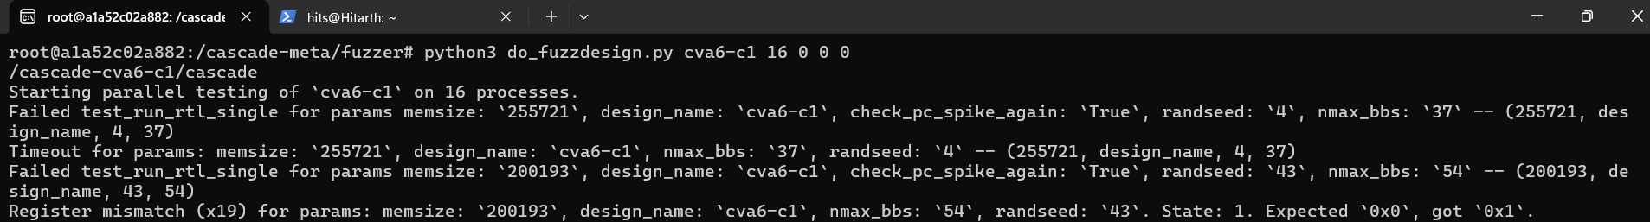
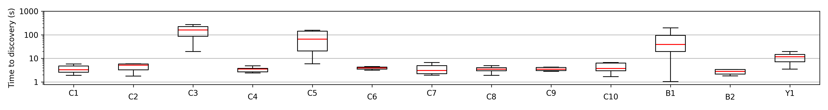
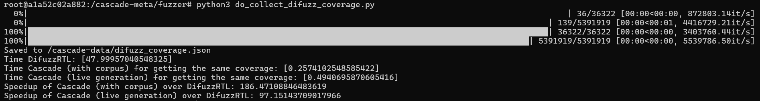
RUNNING CASCADE
FIGURE 1 : Rediscovering paper bugs (Running the Fuzzer on CVA-6)
FIGURE 2: Reproducing bug detection timings for CVA6 and Boom CPUs
FIGURE 3: Register Coverage Comparison between Cascade and DifuzzRTL

Slide 5
FINDINGS
GAP - 1
GAP-2
Lower weight of FPU instruction class and edge-case triggering FPU instructions
- Injection of IEEE 754 special values missing
- No comparison of fflags CSR (5 IEEE 754 exception flags)

Slide 6
ENHANCEMENT - I
WEIGHT BOOSTING
Increased FPU instruction class weights and edge-case-triggering instructions
INSTRUCTION TELEMETRY
Addition of a global counter to track every instruction picked
EDGE CASE VALUE INJECTOR
Injects IEEE 754 special bit patterns directly into FP registers

Slide 7
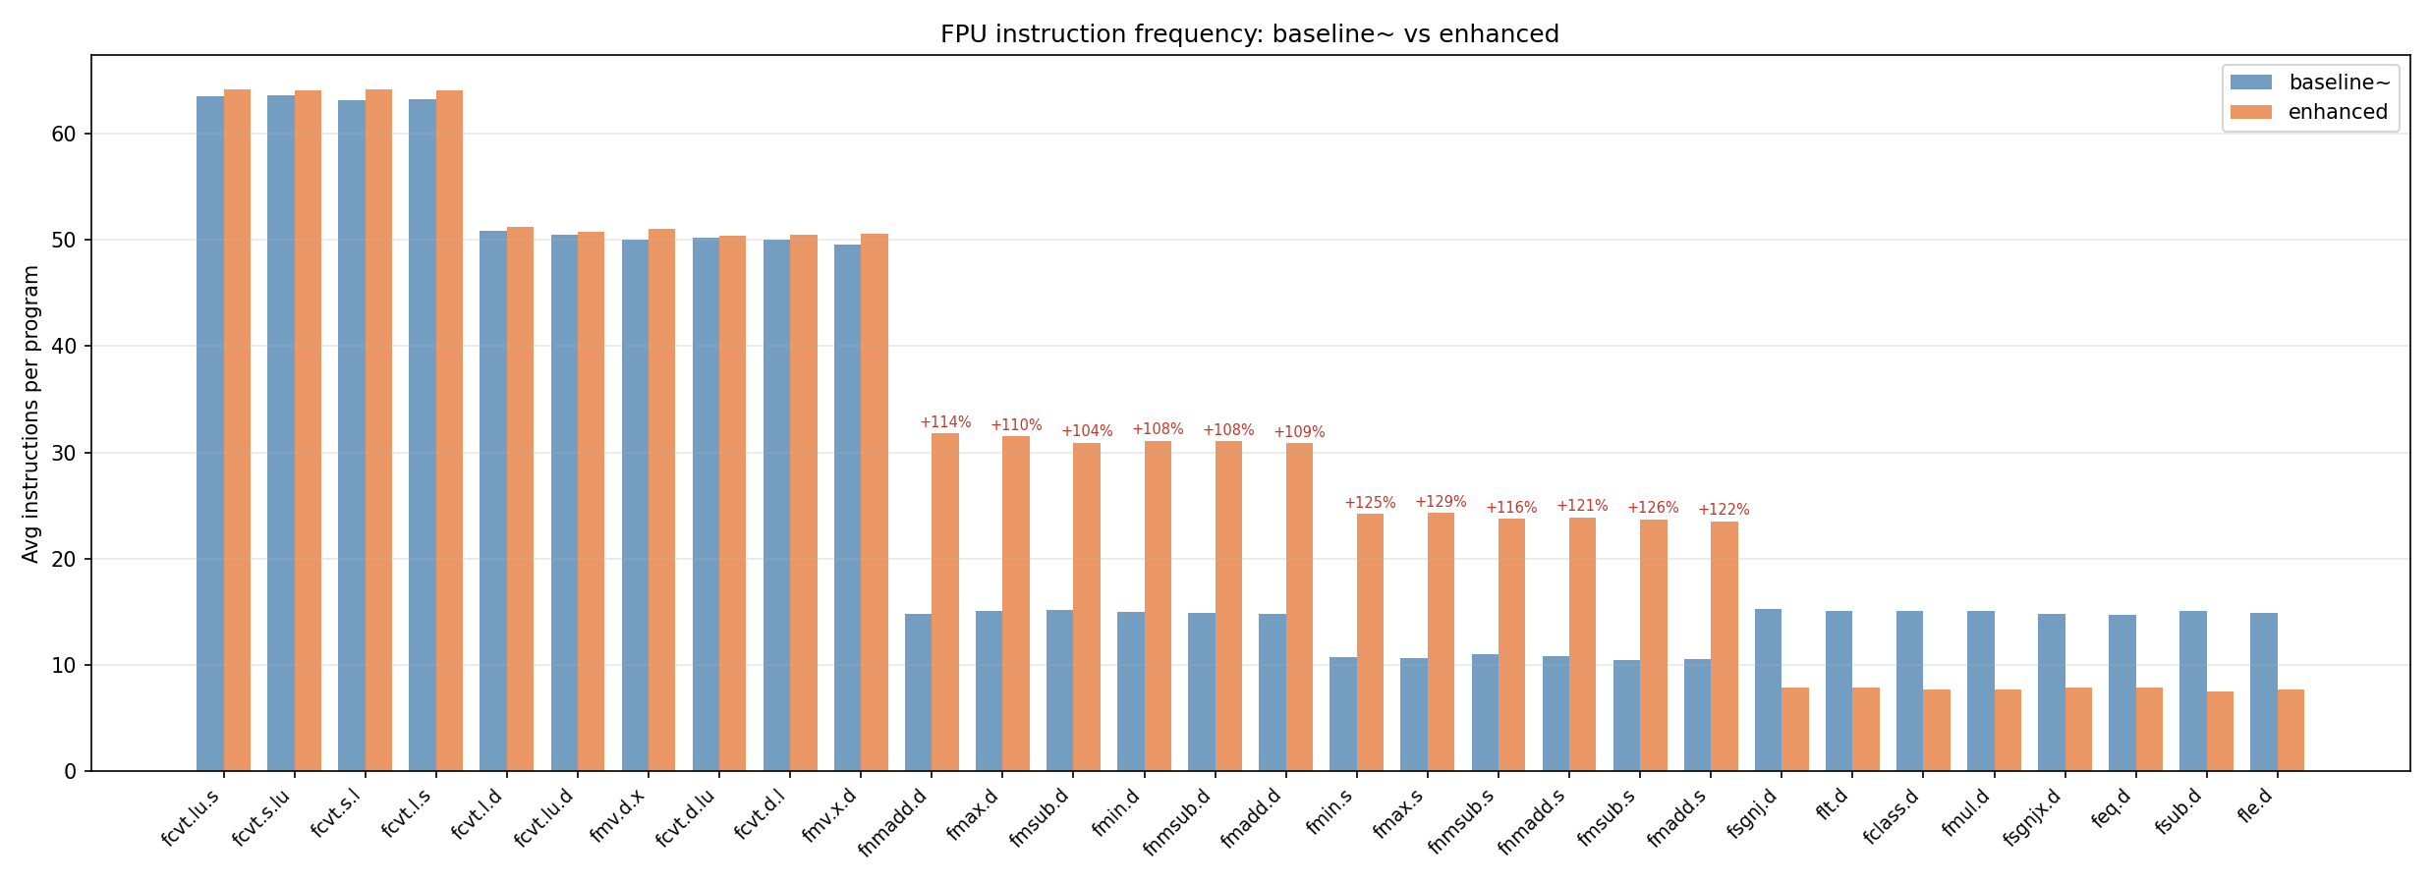
ENHANCEMENT-1 RESULTS

Slide 8
KEY FINDING GAP-II

Slide 9
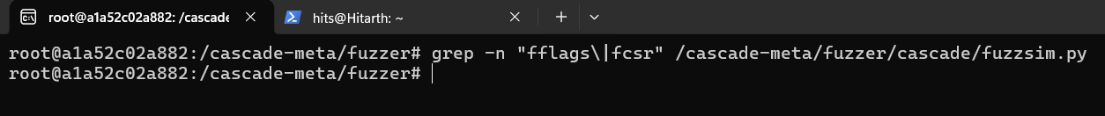
STRUCTURAL GAP IN CASCADE
Analysis of source code reveals:
Comparison never checks fflags
Spike reads fcsr but throws it away

Slide 10
WHAT ARE FFLAGS?
INVALID OPERATION
DIVIDE BY ZERO
OVERFLOW
UNDERFLOW
INEXACT
CSR
BIT 4
BIT 3
BIT 2
BIT 1
BIT 0
fflags is a 5-bit RISC-V CSR representing IEEE 754 accrued exception flags

Slide 11
REDISCOVERY OF BUG V2
BUG V2: “fmin with one NaN does not always return the other operand”
IDEAL BEHAVIOUR: fmin(NaN, 1.0) returns 1.0 and sets NV (bit-4) of fflags CSR
CASCADE FINDING
OUR FINDING
We discovered that the same bug as an Archflags bug (wrong status flags)
V2 has a second, independent symptom - wrong fflags, that persists across all 5 VexRiscv variants, is invisible to the original Cascade oracle
The paper found V2 as an Archvals bug (wrong result value).
Some VexRiscv versions returned the wrong value (NaN instead of 1.0) for fmin when one operand was NaN.

Slide 12
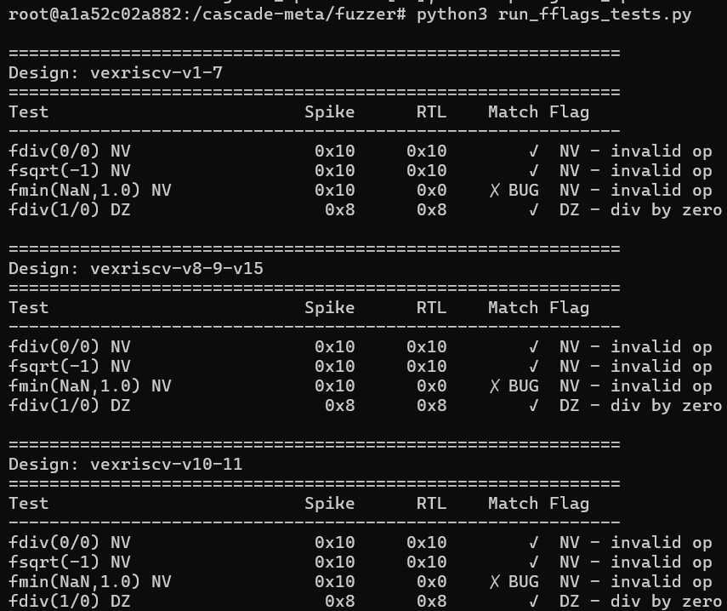
REDISCOVERY OF BUG V2 – OUR FINDING
Targeted Test
Compiled a minimal 6-instruction RISC-V program:
inject qNaN (0x7FC00000) via fmv.w.x
execute fmin.s
read fflags via frflags
dump to memory using Cascade's register dump protocol.
Compared Spike vs RTL
Spike: fflags = 0x10 (NV flag set)
VexRiscv RTL: fflags = 0x00 (NV not set)
Result value: both return 1.0 — Cascade sees no mismatch

Slide 13
Discovery of a new bug
BUG
CVA6 sets NX (inexact) exception flag for fsqrt results including exact ones
IDEAL BEHAVIOUR
fsqrt.s is the RISC-V single-precision square root instruction. When it executes, two things happen:
Result : The square root value is written to the destination FP
fflags : The NX (inexact) exception flag should be set only if the result could not be represented exactly

Slide 14
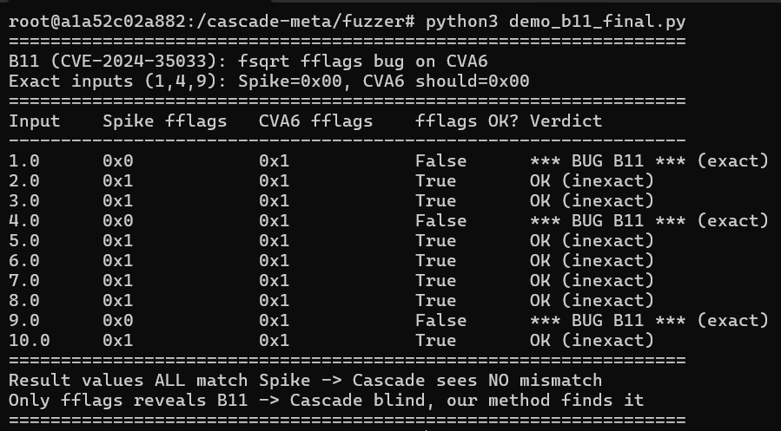
Discovery of a new bug
How we discovered it?
Identified fsqrt.s instruction suppression in Cascade oracle
Built a targeted test to execute fsqrt.s and read fflags
Compared results of Spike and CVA6 RTL to discover it

Slide 15
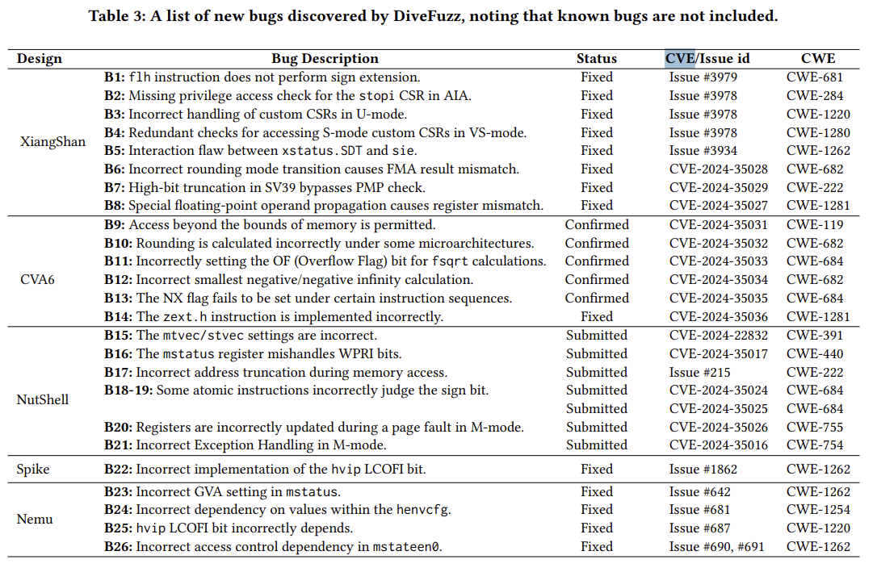
Discovery of a new bug
We found a spurious NX flag bug on CVA6's fsqrt for exact inputs
Related but distinct manifestation from B11/B13, in the same fsqrt exception flag logic that DiveFuzz (CCS’25) identified as buggy.

Slide 16
SUMMARY
Identified a structural blind spot in Cascade (USENIX Security ‘24)
Implemented IEEE 754 special value injection
Demonstrated the gap is real and exploitable

Slide 17
THANK YOU

